Slide 1


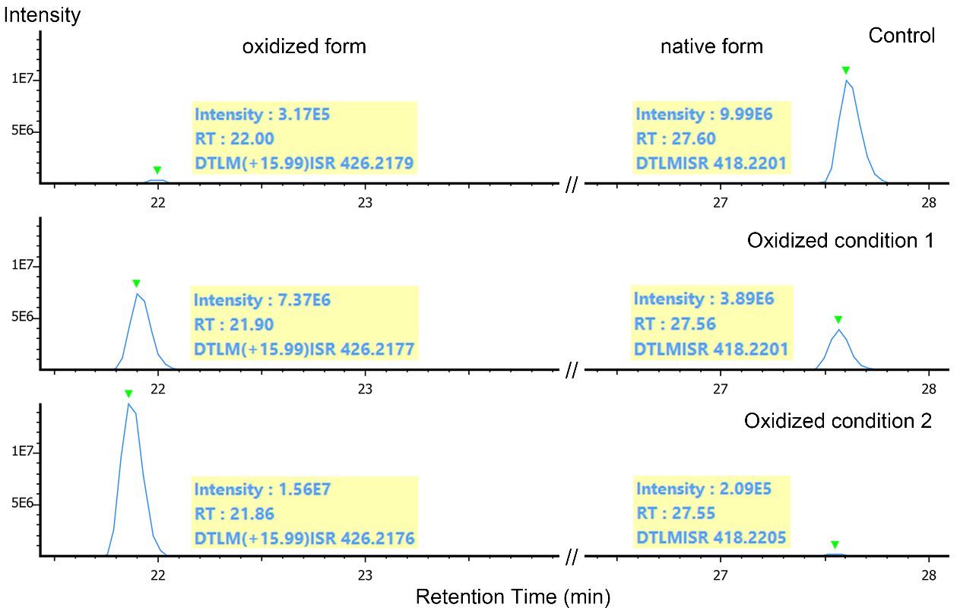
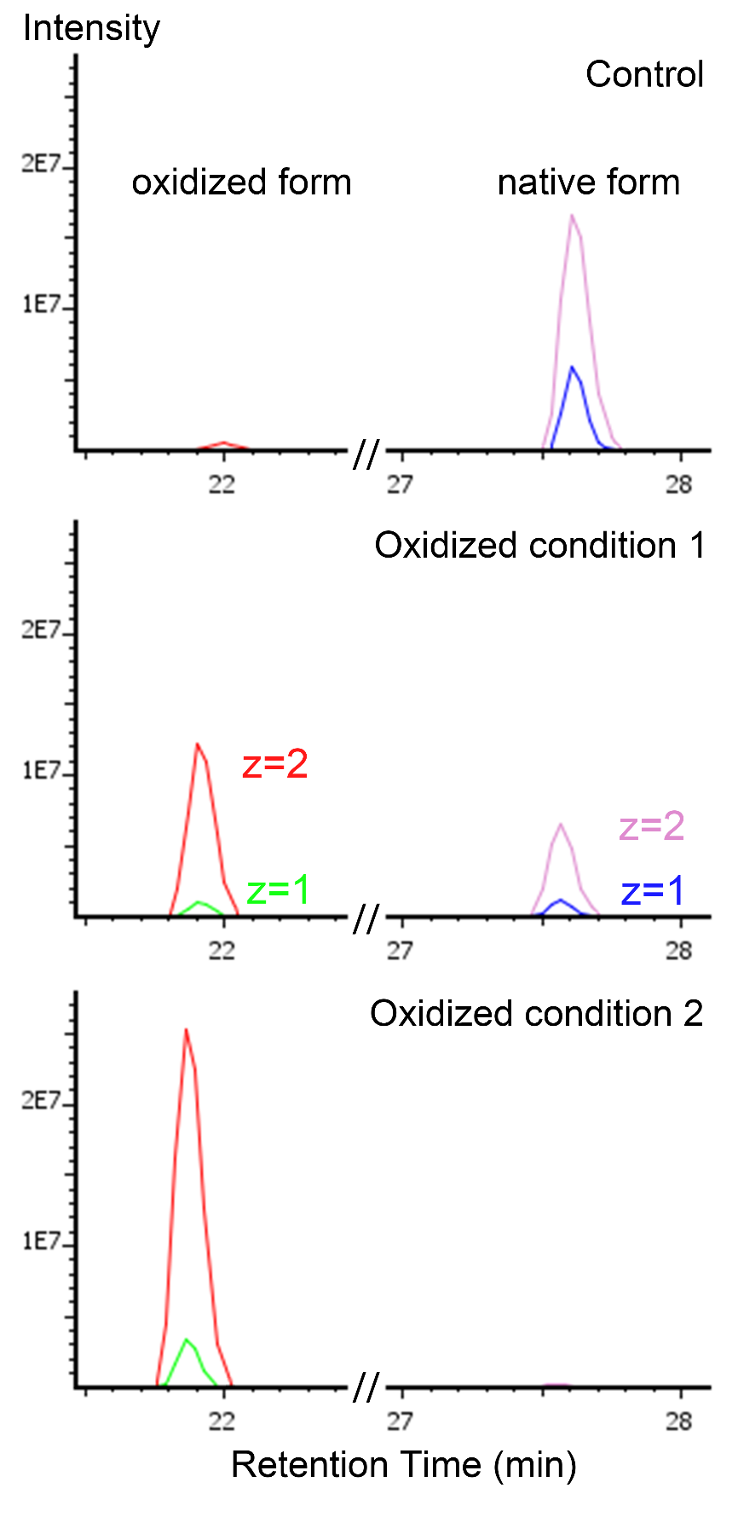
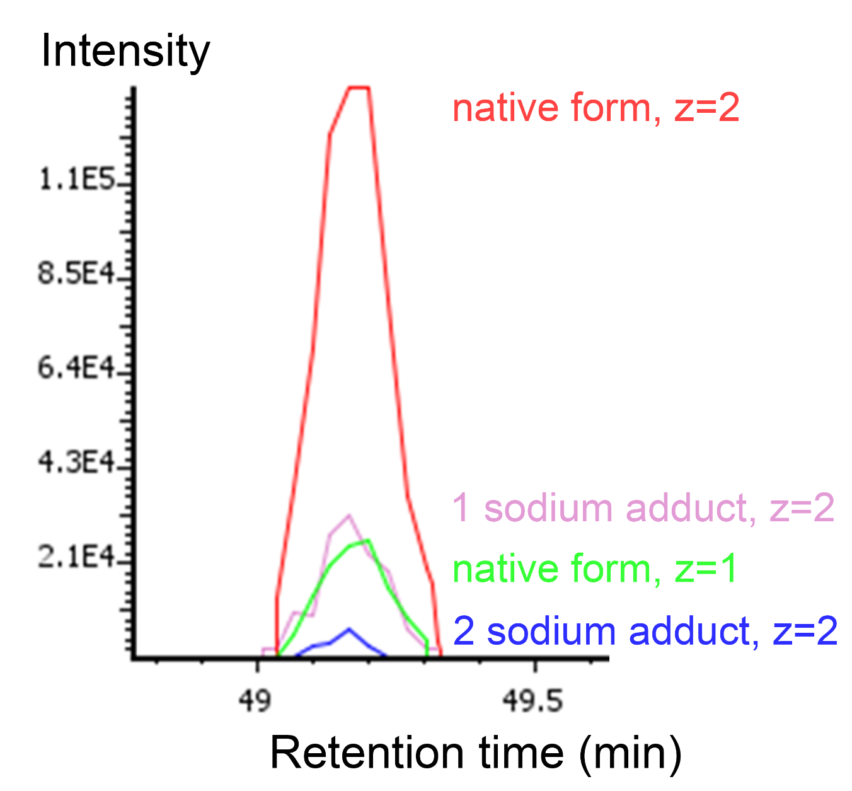
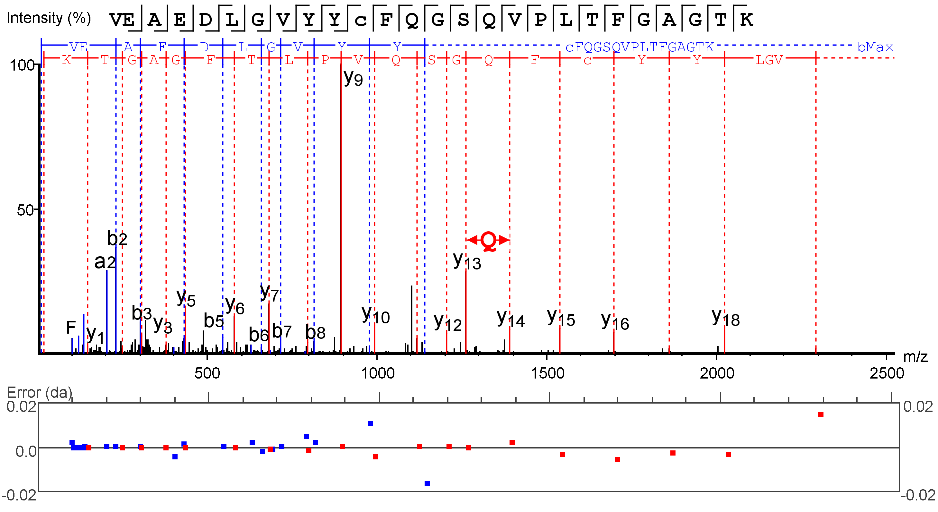
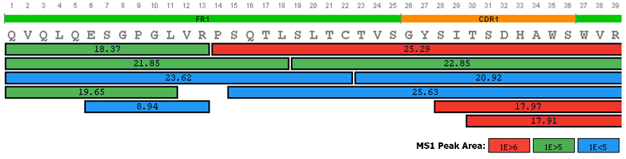
New Peptide Mapping Approaches for Complete Characterization of Purified Antibodies
Bioinformatics Solutions Inc.
Wen Zhang, Yifang Chen, Lei Xin, Lin He, Baozhen Shan
Bioinformatics Solutions Inc., Waterloo, Ontario, Canada
Introduction
Results
Studies of therapeutic proteins, especially monoclonal antibodies (mAb), require complete characterization of a protein’s full sequence and each amino acid’s surrounding environment for quality control. Peptide mapping is a critical quality test procedure commonly used to confirm desired biotherapeutic protein structure. Accurate and sensitive identification and quantification of product-related impurities, such as post-translational modifications (PTMs), fragmentation (degradation), and amino acid mutations, are essential for such analysis however challenging due to their low abundance and variations across samples, which requires tedious manual work for confirmation. With current liquid chromatography (LC) and mass spectrometry (MS) technologies, we presented new peptide mapping analysis workflow to confidently validate protein sequence and its related impurities with high accuracy and sensitivity.
Quantitative PTM analysis
Amount of the native peptide, DTLMISR, decreased whereas its oxidized form abundance increased from control to two oxidized conditions. Base peak chromatograms are annotated and shown above. Extracted ion chromatograms of native peptide and its oxidized forms are shown on right.
Co-eluted native peptide and its sodium adduct forms were identified with their extracted ion chromatograms shown below.
Summary
The results demonstrated that the new peptide mapping method can confirm amino acid sequence, identify and quantify PTMs and discover sequence variants with high accuracy and sensitivity in a time efficient way.
Methods
New peptide mapping analysis workflow can take LC-MS and/or LC-MS/MS data from enzymatic digestions of purified proteins.
Peptide features are detected by new algorithm for peak picking.
Retention time and elution profile, along with de novo sequencing combined with database search for tandem mass spectra are used for peptide identification.
PTM and homologous search are used to identify additional unspecified PTMs and potential sequence variants.
MS1 features are detected, aligned between samples, mapped to in silico digested peptides from the database, and integrate with MS2 identifications for more accurate and sensitive PTM and mutation discovery.
Two standard mAb samples, i.e. Intact mAb Mass Check Standard (Waters) and NIST, were reduced, alkylated, digested by trypsin, purified and analyzed by high resolution LC-MS/MS.
Identification of Sequence Variants
Native: VEAEDLGVYYCFQGSHVPLTFGAGTK, MS1 peak area: 1.3E8
Variant: VEAEDLGVYYCFQGSQVPLTFGAGTK, MS1 peak area: 2.3E6
Results
Protein Sequence Coverage
Contact
support@bioinfor.com www.bioinfor.com Bioinformatics Solutions Inc.

